Slide 1


2019 TECH(K)NOW Day Taipei
Let’s
For Web!
Benjamin Wang @ Golang Taiwan
2019.4.20
Notes:
https://github.com/golang-samples/gopher-vector

Slide 2
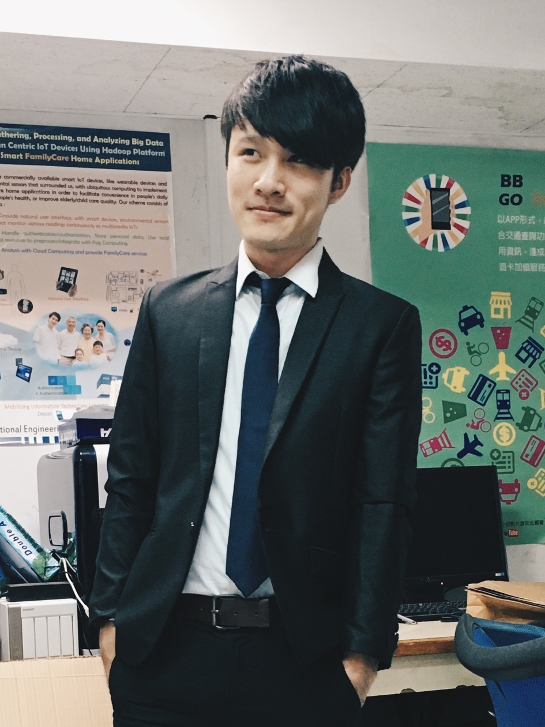

Hi, I’m Benjamin Wang
Golang Taiwan Core member
ASUS Engineer
- Golang, Android, Node.js, …
V-Hub.org Co-founder
Tiger Accelerator DevOps
https://t.me/syxuan

Slide 3
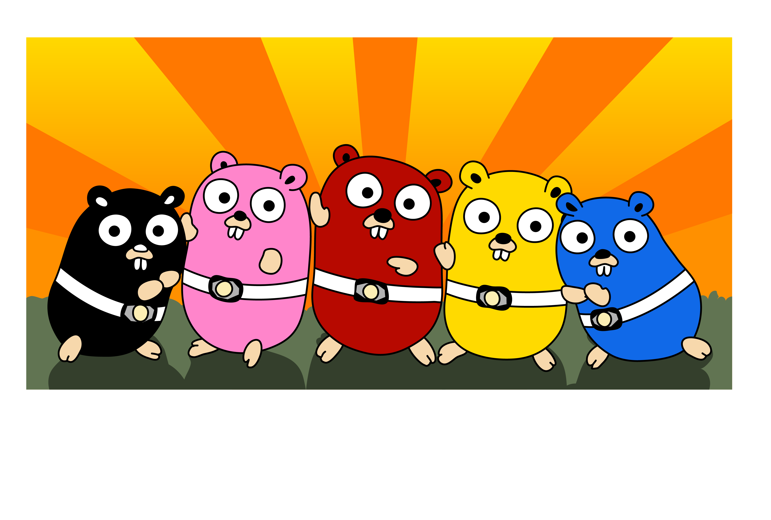


Golang Taiwan
https://www.meetup.com/golang-taipei-meetup/
https://t.me/golangtw
https://www.facebook.com/groups/269001993248363/

Slide 4
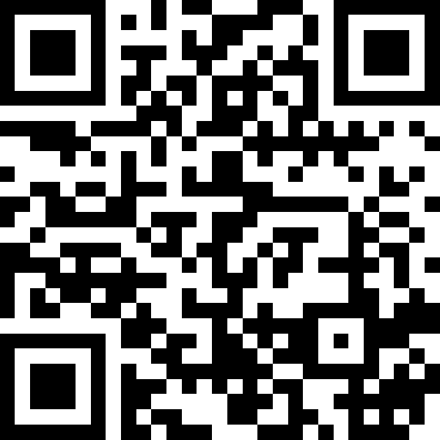

Slide 5
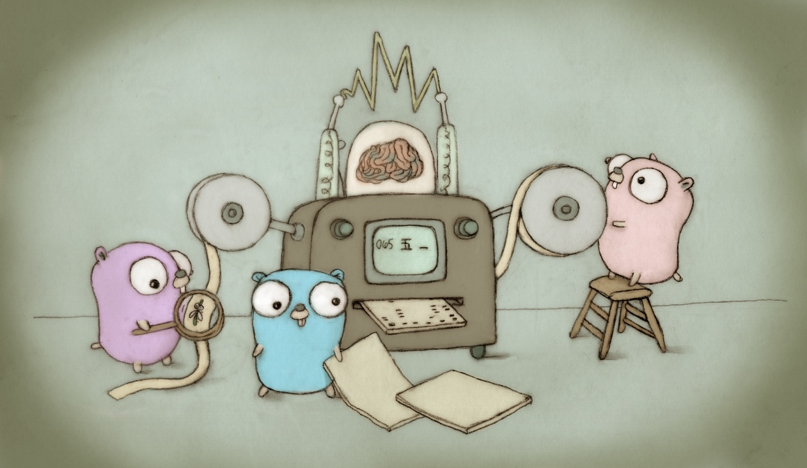
Notes:
特徵:系統底層專屬
資源:不算特別豐富但正快速完善
天賦:出生名門，高速高性能。無視智力剝奪詛咒

Slide 6
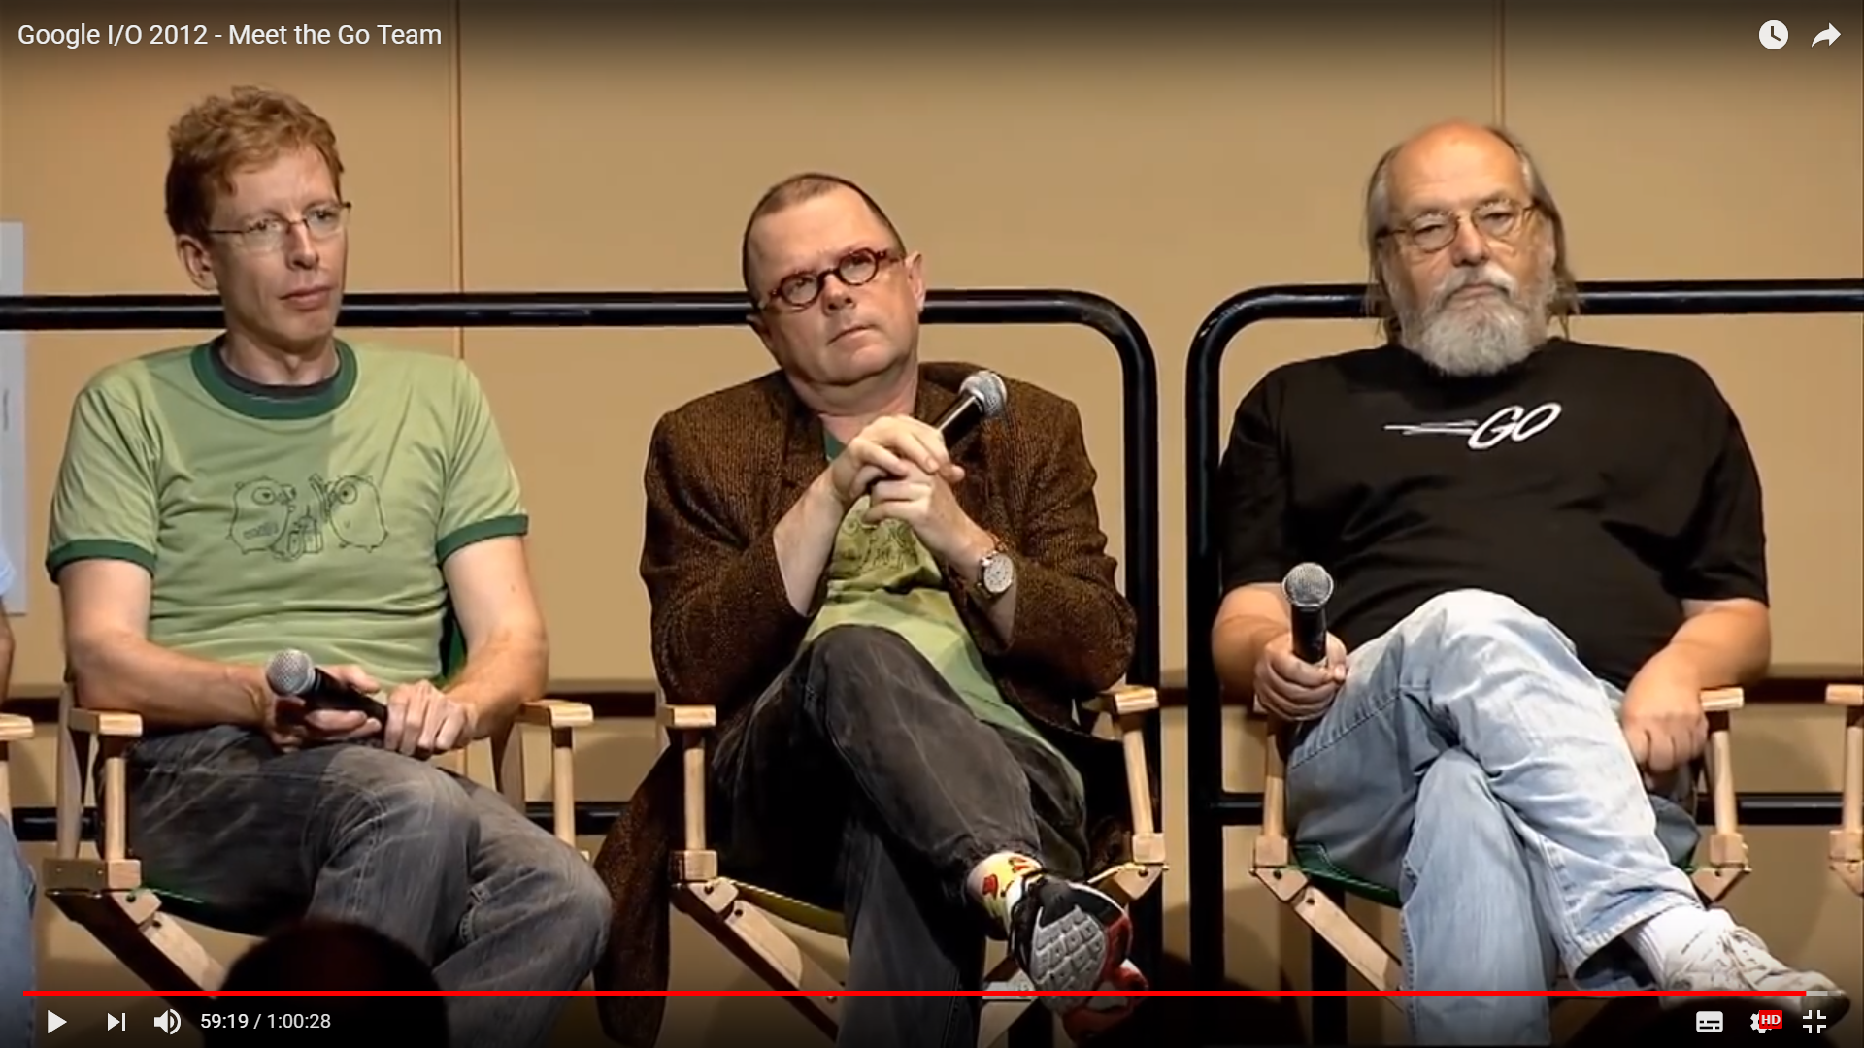
Rob Pike
UTF-8,
Plan 9 from Bell Labs
Ken Thompson
UNIX, B, C++, Plan 9
Robert Griesemer
HotSpot, V8
Notes:
Robert Griesemer:
Google的工程師，參與了V8 JavaScript引擎Java HotSpot編譯器和Chubby的開發，也是Strongtalk虛擬機最重要的開發者之一。
Java虛擬機是在Strongtalk基礎上產生的。
Rob Pike:
貝爾實驗室的Unix小組成員，Plan9主要開發者，分布式開發系統Inferno開發者，UTF-8創建者，一個與眾不同的編譯器acme發明人。
他最喜歡做的事情貌似有以下幾件:發明作業系統、編譯器、語言。
Ken Thompson:
計算機歷史上最重要的人物之一。1983年圖靈獎和98年美國國家技術獎得主。
Unix之父，B語言發明者，C語言共同發明者，UTF-8發明者，Plan9開發者，ed編輯器作者。
Ed是所有編輯器的起點(包刮vi和emcas)

Slide 7
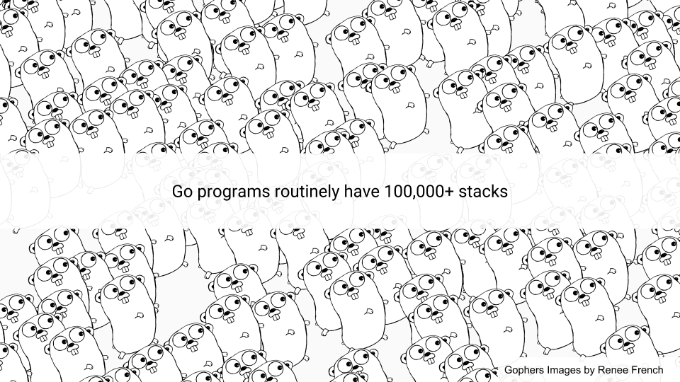
Notes:
四個重要的建構者中有3個都是Plan9的核心成員
Rob Pike的夫人Renee French設計的
Renee French是一位美國插畫師及童書作者

Slide 8



2013.03
2014.06
Notes:
2013年3月 Docker發布第一個版本，完全使用GO
2014年6月 kubernetes也稱作k8s，由google發起維護的自動化容器集群管理開源平台

Slide 9

Notes:
2013年3月 Docker發布第一個版本，完全使用GO

Slide 10
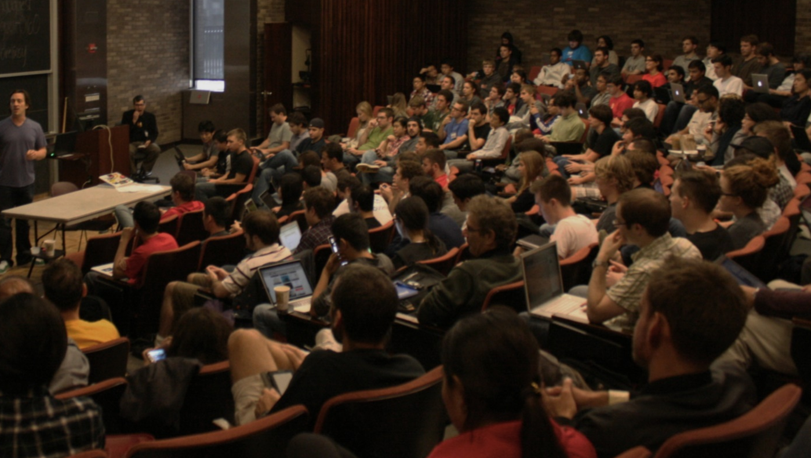
Communication

Slide 11

What can you do?
Notes:
https://www.flickr.com/photos/zeeyolqpictures/13190070673/sizes/h/

Slide 12
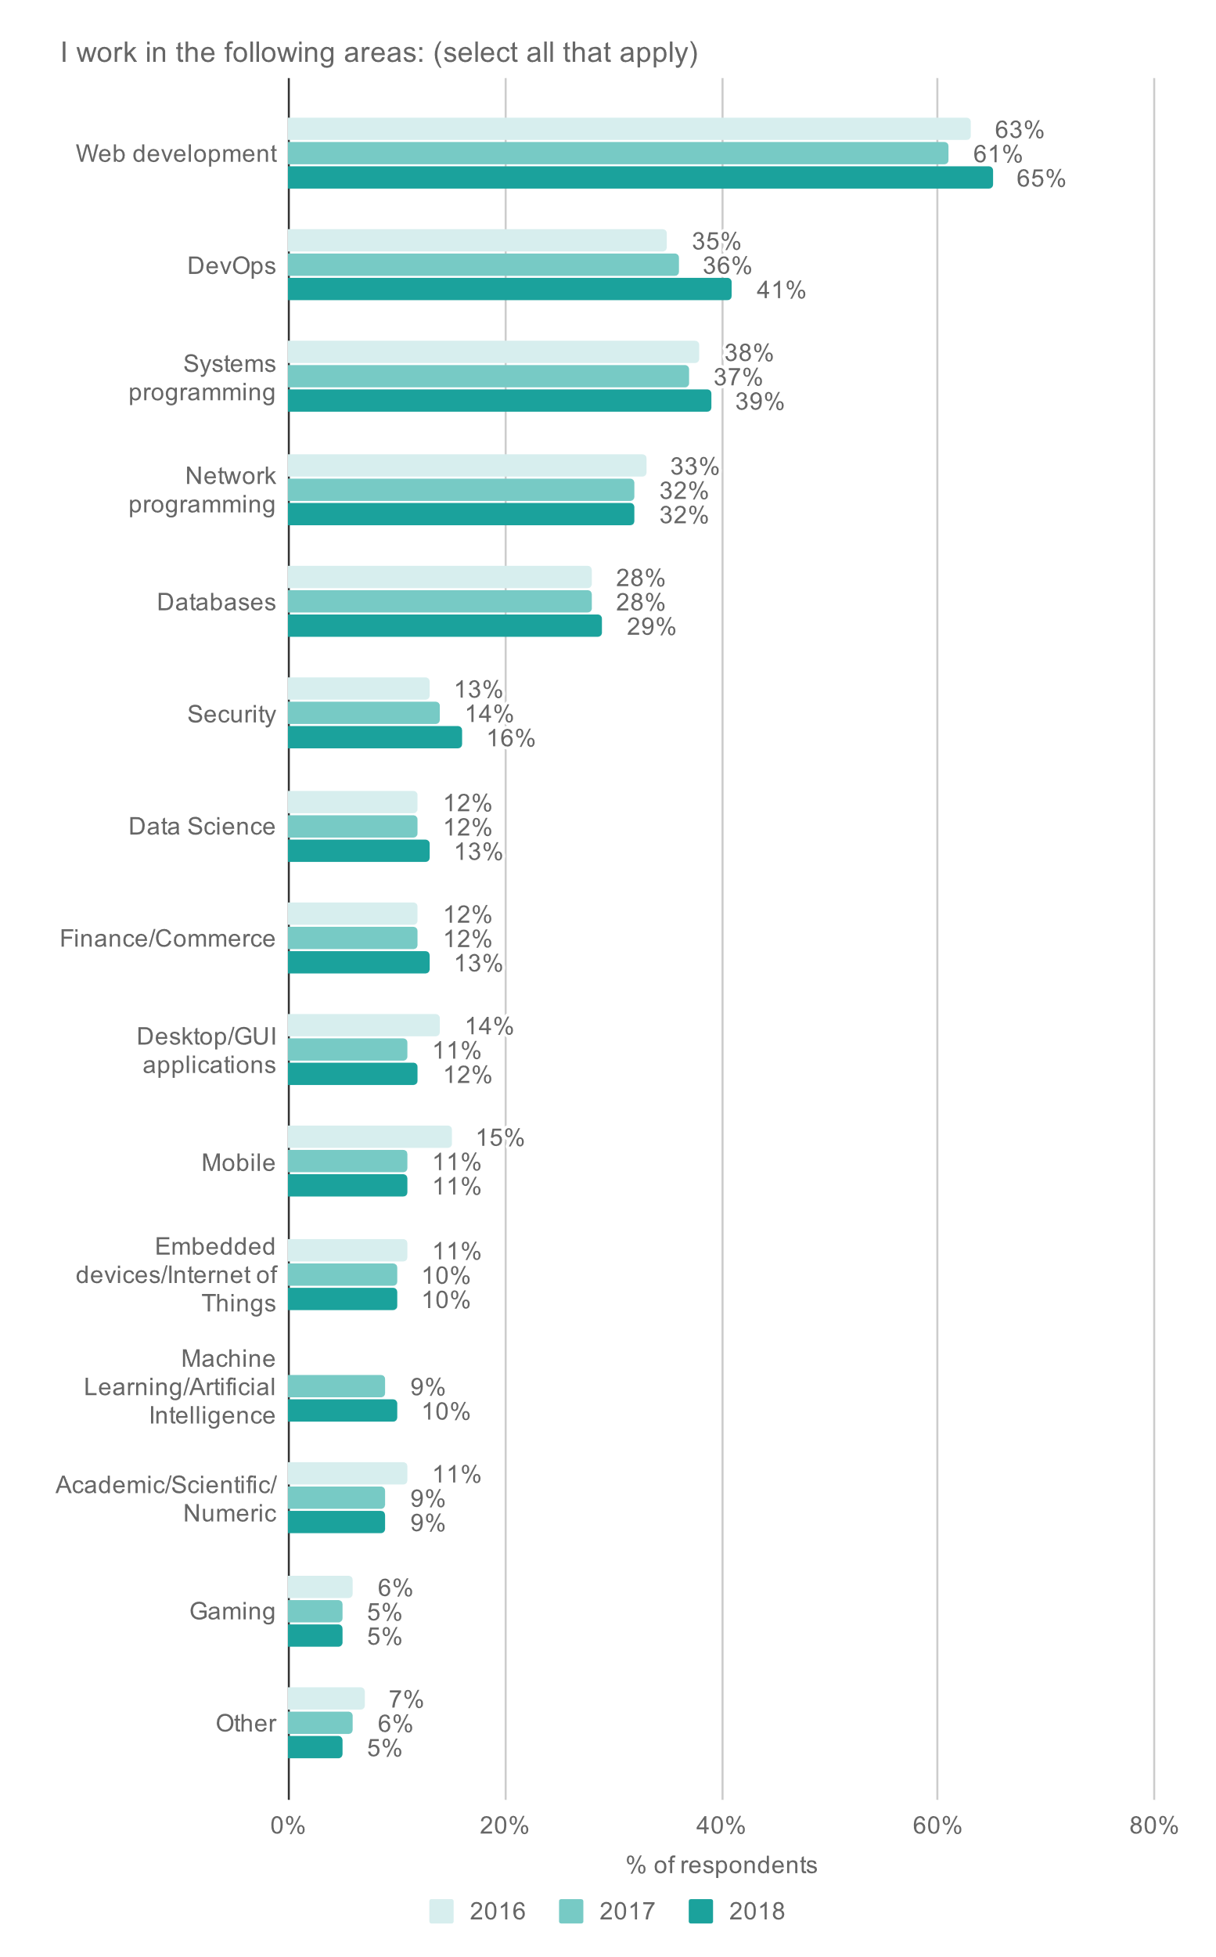
https://blog.golang.org/survey2018-results

Slide 13

Getting Started
https://github.com/jmhobbs/party-gopher

Slide 14
CONTENTS
Intrudoction
Install
Basic Knowledge
RESTful API
HTML Template
Static Assets
Post Form
User Login
Cookie
Socket

Slide 15
Keywords
break default func interface select
case defer go map struct
chan else goto package switch
const fallthrough if range type
continue for import return var
Notes:
It has only 25 keywords... Even less than the 26 letters of the English alphabet

Slide 16
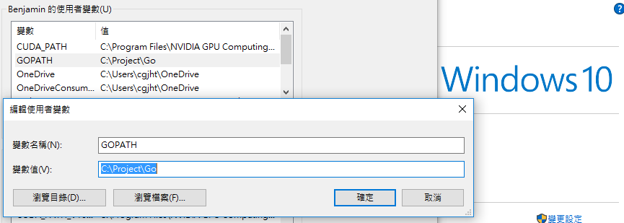
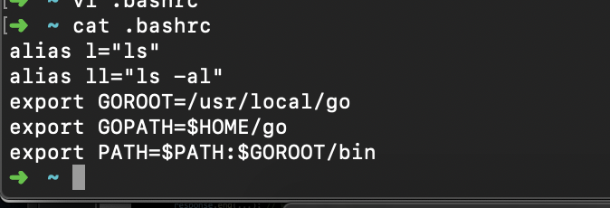
https://golang.org/doc/install
Linux, macOS
Edit $HOME/.profile or .bash_profile or .bashrc
export GOROOT=/usr/local/go
export GOPATH=[PathToProject]
export PATH=$PATH:$GOROOT/bin
Windows

Slide 17
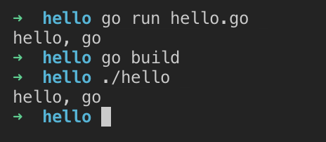
$GOPATH/src/hello/hello.go
package main
import "fmt"
func main() {
fmt.Println("hello, go")
}
Notes:
每個go專案都要有一個main package
這裡用到fmt這個package
可以直接go run也可以go build

Slide 18
In $GOPATH, you must have three folders as follows
src: for source files whose suffix is .go, .c, .g, .s
pkg: for compiled files whose suffix is .a
bin: for executable files

Slide 19
Package
import (
"fmt"
)
func main() {
fmt.Println("hello go")
}

Slide 20
Define variables
var variableName type
var vname1, vname2, vname3 type
var (
vname1 type
vname2 type
vname3 type
)
vname1, vname2, vname3 := v1, v2, v3

Slide 21
Error types
err := errors.New("emit macho dwarf: elf header corrupted")
if err != nil {
fmt.Print(err)
}
Notes:
Golang 沒有try catch
用error來接

Slide 22
if
if x > 10 {
fmt.Println("x is greater than 10")
} else {
fmt.Println("x is less than 10")
}
if x := computedValue(); x > 10 {
fmt.Println("x is greater than 10")
} else {
fmt.Println("x is less than 10")
}

Slide 23
for
sum := 0;
for index:=0; index < 10 ; index++ {
sum += index
}
for ; sum < 1000; {
sum += sum
}
for sum < 1000 {
sum += sum
}

Slide 24
for (cont.)
for k,v:=range map {
fmt.Println("map's key:",k)
fmt.Println("map's val:",v)
}
for _, v := range map{
fmt.Println("map's val:", v)
}

Slide 25
Functions
func max(a, b int) int {
if a > b {
return a
}
return b
}
func main() {
x := 3
y := 4
max_xy := max(x, y) // call function max(x, y)
fmt.Printf("max(%d, %d) = %d\n", x, y, max_xy)
}
Notes:
每個帶入參數必須要指定類型
返回值可宣告變數或不宣告，但是一定要有類型

Slide 26
Functions (cont.)
func SumAndProduct(A, B int) (int, int) {
return A+B, A*B
}
func main() {
x := 3
y := 4
xPLUSy, xTIMESy := SumAndProduct(x, y)
fmt.Printf("%d + %d = %d\n", x, y, xPLUSy)
fmt.Printf("%d * %d = %d\n", x, y, xTIMESy)
}

Slide 27
Functions (cont.)
func SumAndProduct(A, B int) (add int, Multiplied int) {
add = A+B
Multiplied = A*B
return
}

Slide 28
Struct
type person struct {
name string
age int
}
var P person
P.name = "Astaxie"
P.age = 25
fmt.Printf("The person's name is %s", P.name)

Slide 29

https://www.calhoun.io/guide-to-go/

